Slide 1
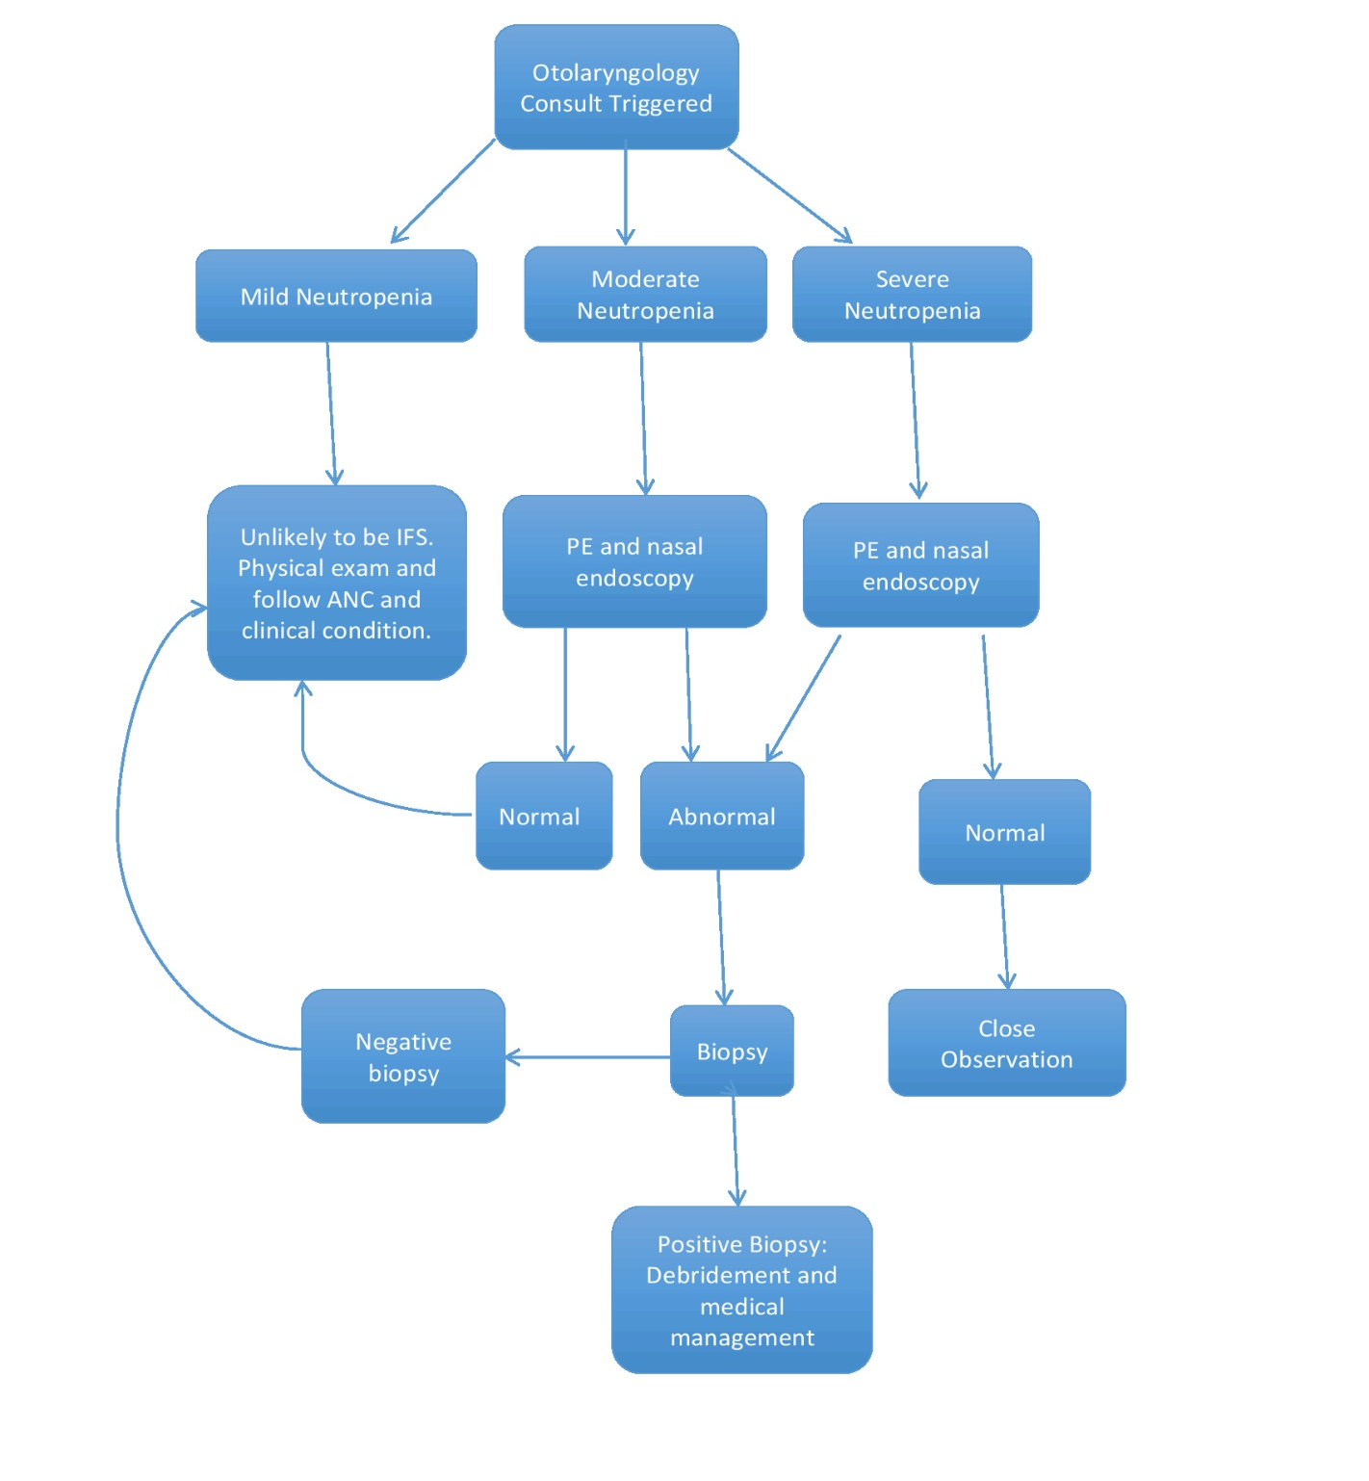
Survival rate ~ 90% at 6 months from diagnosis

